Slide 1
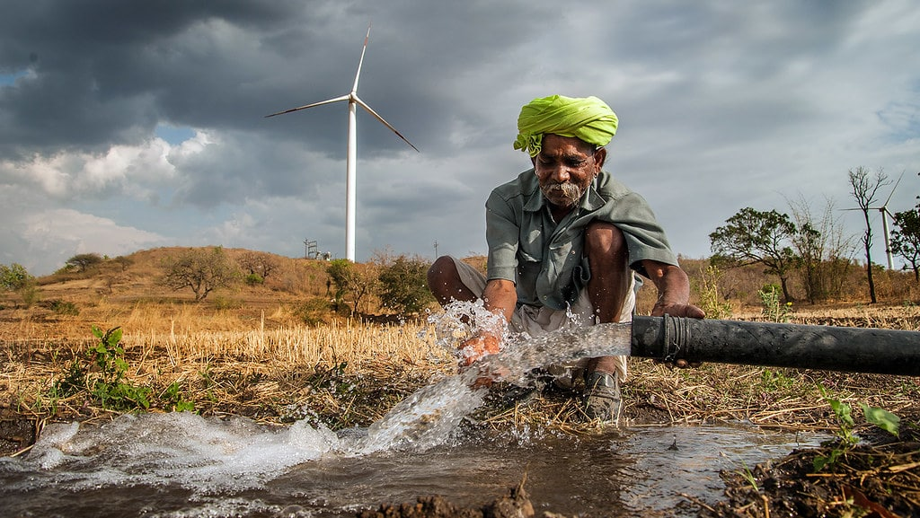
Modern breaching
TEAM MENBERS
1]DILEEP SAI LAVU
2]ANIL KUMAR.
3]SAI RISHAL

Slide 2
ABSTRACT
Agriculture now-a-days became so easy by the use of various mechines but there are even more problems that are not solved yet .
One of the problem we get to know is Breaching manually while Rainfalls .
Our idea is to implement Breaching through small farm dams without any manually work.

Slide 3
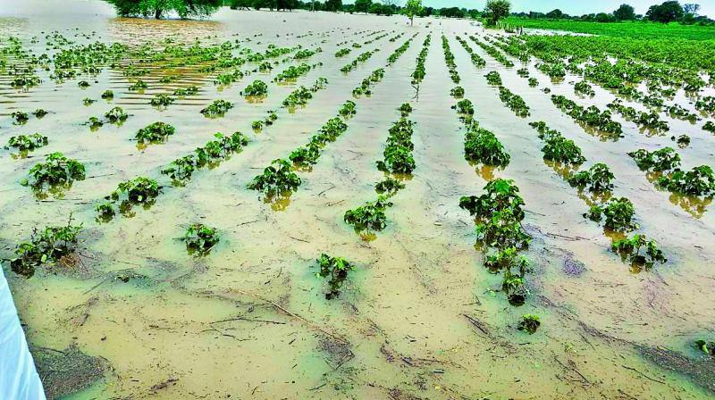
Problem statement
The crops which are submerged in water will die due to inability to exchange atmospheric gases.
Farmers will be unable to access their fields.
Crop yields will fall dramatically.
There will be a loss of money due to low yield as well as the cost of applying fertilizers and fertilizers again.

Slide 4

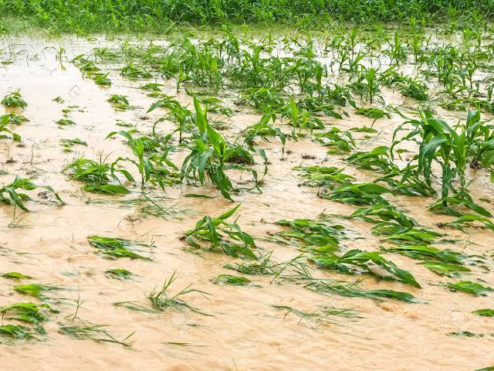
Introduction
Our project consists of two main domains :
1] making water to leave from farm land to out
2]making the water which is out to enter into the water resourses

Slide 5
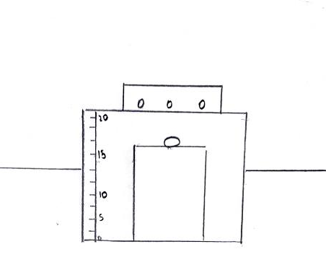
DOAMIN 1
For this process we fix a farm dam in agriculture fields which consists a water sencor which is fixed through some water limit .for example,paddy crop can exist and grow when there is the water level of 10-15cm in the field.such that now we can set the limit of 15cm to the sensor .When ever the water level increases more than the limit the water is sent out of the field through dams which we have build.

Slide 6
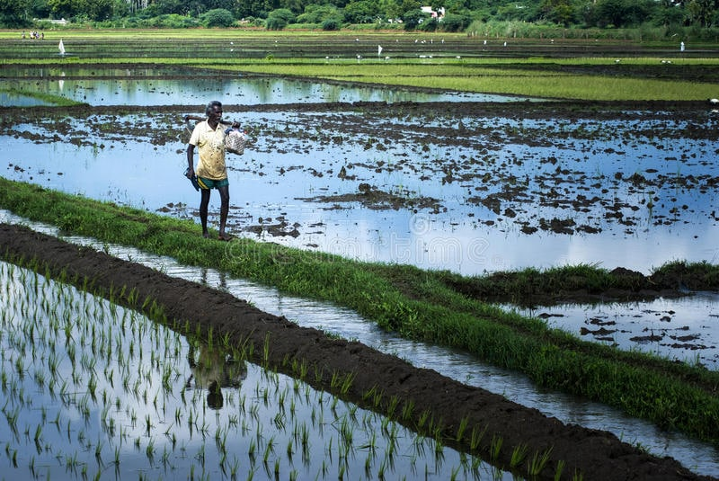
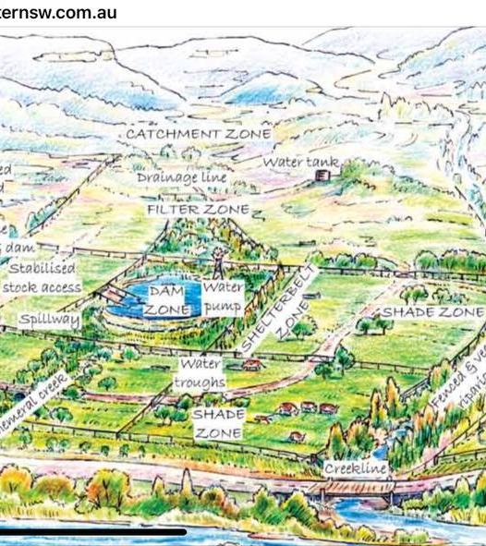
Domian 2
After completing first process now water which has been sent out has to be stored in a water resourse .For this process we will connect all the crops and making those connections connected to the water resourse.

Slide 7
Hardware requirements
Main water resource
Awareness of water level of each crop
Electric resourse
Stable plantation

Slide 8
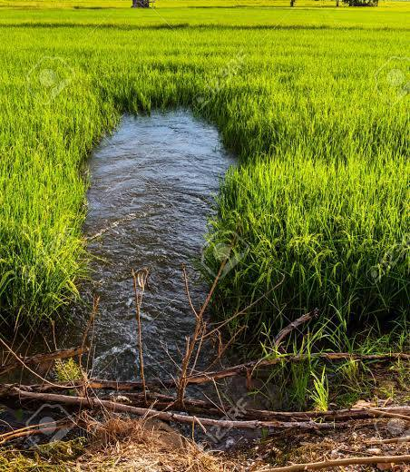
Scope of the project
Making Breaching methodology possible without any manual interaction with humans

Slide 9

Thank you

